Slide 1




Andrew Pettus
Notes:
Howdy everybody! Thanks for being here today. This is a great way to kick off our brand new club, getting right into a topic and going hands on with some development kits.
>Some background on me:
>I’ve been tech oriented my entire life with a focus on HW.

Slide 2
Andrew Pettus
Tech oriented my whole life with a focus on hardware
Notes:
Some background on me:
I’ve been tech oriented my entire life with a focus on HW. My dad used to show me how to put together electronics in our garage when I was a kid.
I got my amateur radio license at age 12; at around the same time I got into scrapping and rebuilding computers.

Slide 3

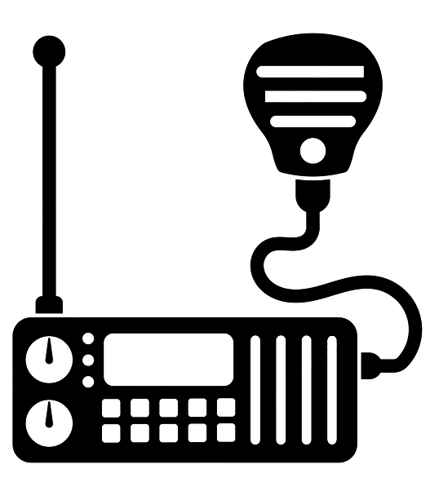

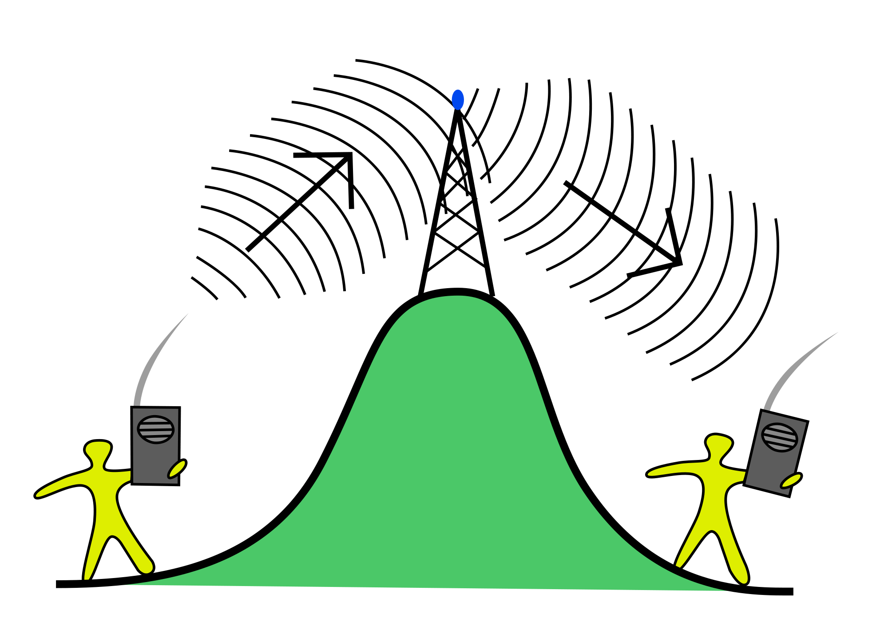

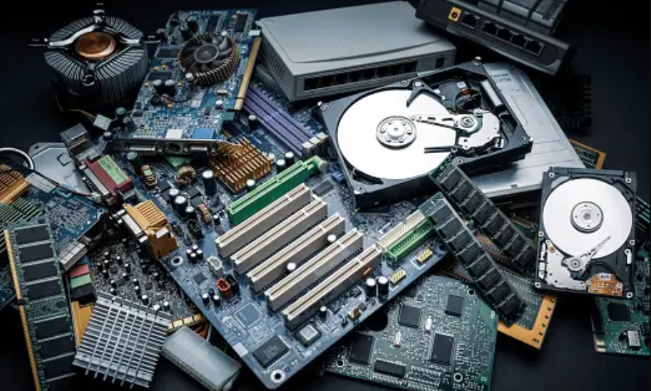
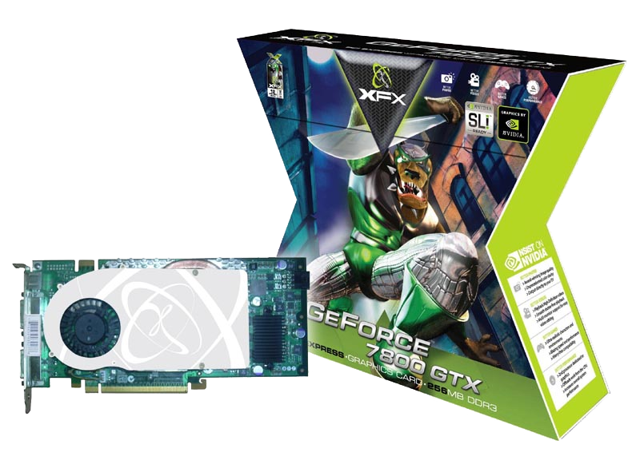
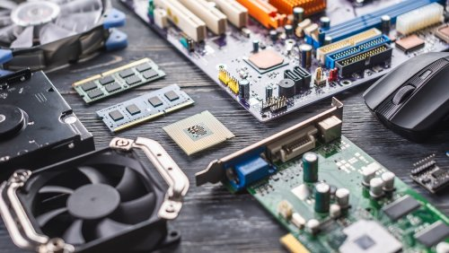
Andrew Pettus
Tech oriented my whole life with a focus on hardware
Amateur Radio and Computers at 12
W6AMP
Notes:
Some background on me:
I’ve been tech oriented my entire life with a focus on HW. My dad used to show me how to put together electronics in our garage when I was a kid.
I got my amateur radio license at age 12; at around the same time I got into scrapping and rebuilding computers.

Slide 4
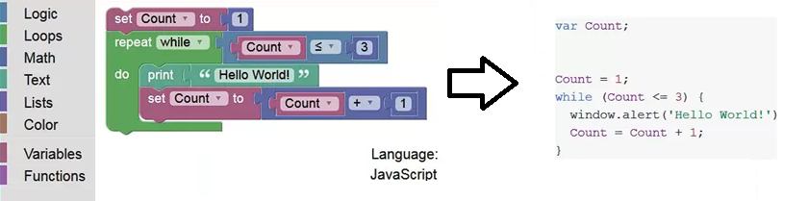
Code averse until recently; Blockly got me started with Python
Andrew Pettus
Tech oriented my whole life with a focus on hardware
<2 Years coding experience
Got into Amateur Radio and Computers at 12
W6AMP
Notes:
Some background on me:
I’ve been tech oriented my entire life with a focus on HW. My dad used to show me how to put together electronics in our garage when I was a kid.
I got my amateur radio license at age 12; at around the same time I got into scrapping and rebuilding computers.
For my software background…

Slide 5



W6AMP
Andrew Pettus
<2 Years coding experience
Familiar with C++, Java, Python
Notes:
2 Years of coding experience
Familiar with C++, Java, and Python in that order

Slide 6
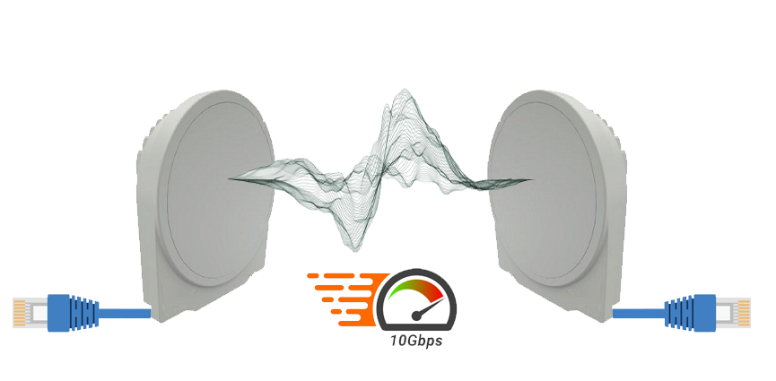

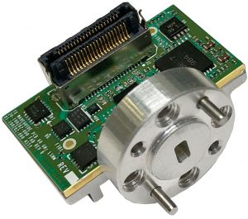
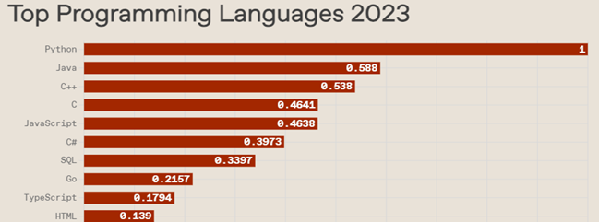
Andrew Pettus
<2 Years coding experience
Familiar with C++, Java, Python
Notes:
I work for a company that makes
High Freq. Radio Technologies and hardware such as:
Point to point radio links,
Novel waveguide technologies,
And developments in RFID. We play around in frequencies ranges of 60GHz to 90GHz; for comparison, common wifi routers are 2.4GHz and 5GHz.

Slide 7
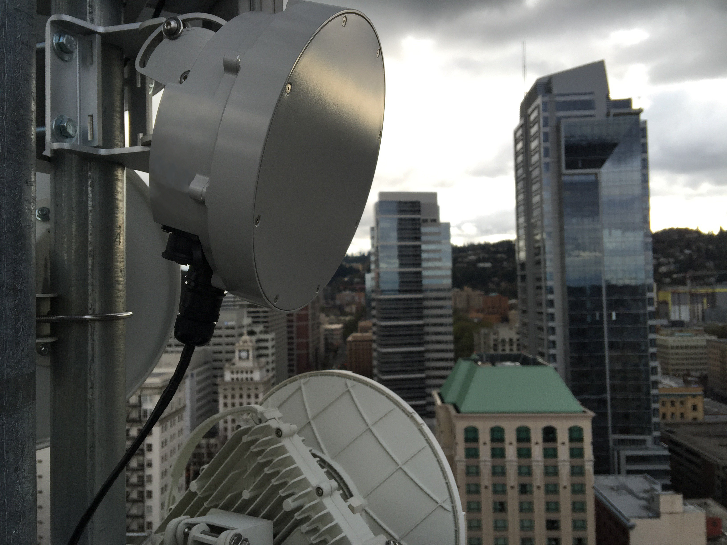

my job
60GHz – 90GHz
Notes:
I work for a company that makes
High Freq. Radio Technologies and hardware such as:
Point to point radio links,
Novel waveguide technologies,
And developments in RFID. We play around in frequencies ranges of 60GHz to 90GHz; for comparison, common wifi routers are 2.4GHz and 5GHz.
>We make cool radios that get put on towers and skyscrapers…

Slide 8
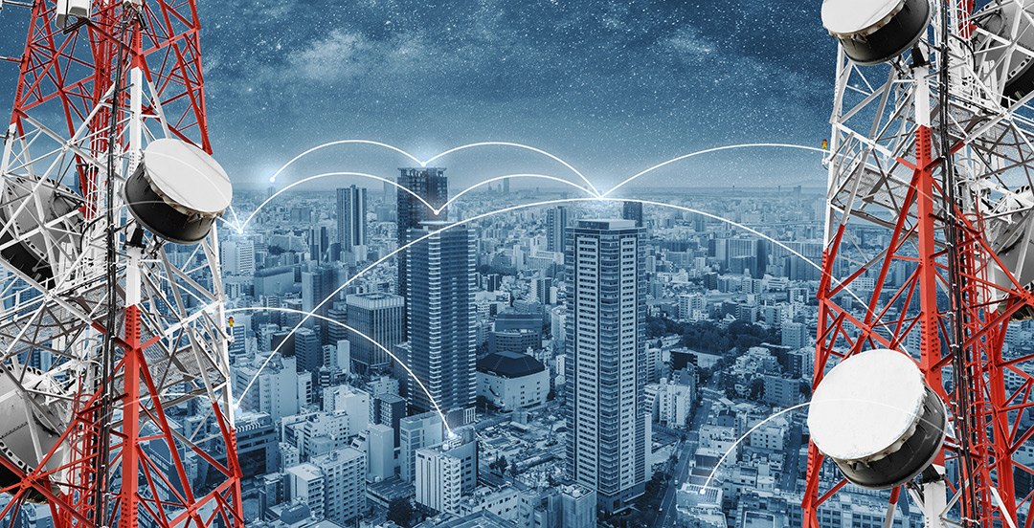
Notes:
We make cool radios that get put on towers and skyscrapers….
>And we help develop radio infrastructure for private entities, public municipalities, and big fish like cell phone companies...

Slide 9
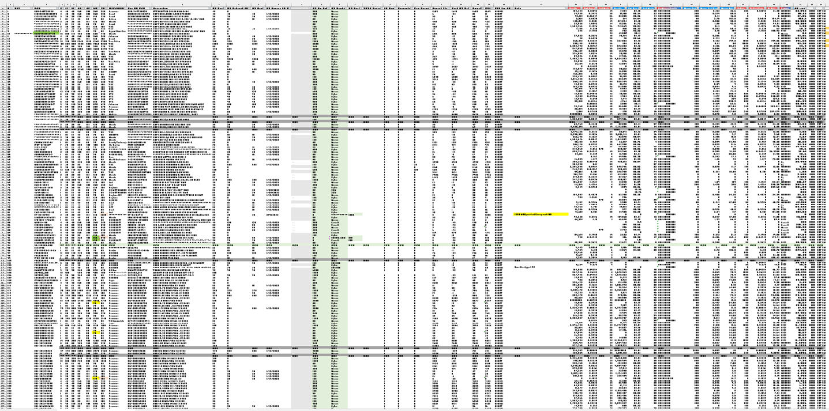
Notes:
And we help develop radio infrastructure for private entities, public municipalities, and big fish like cell phone companies.
>But what I spend a lot of time actually doing is looking at huge spreadsheets like this one. This is an actual bill of material spreadsheet I used a few weeks ago.

Slide 10
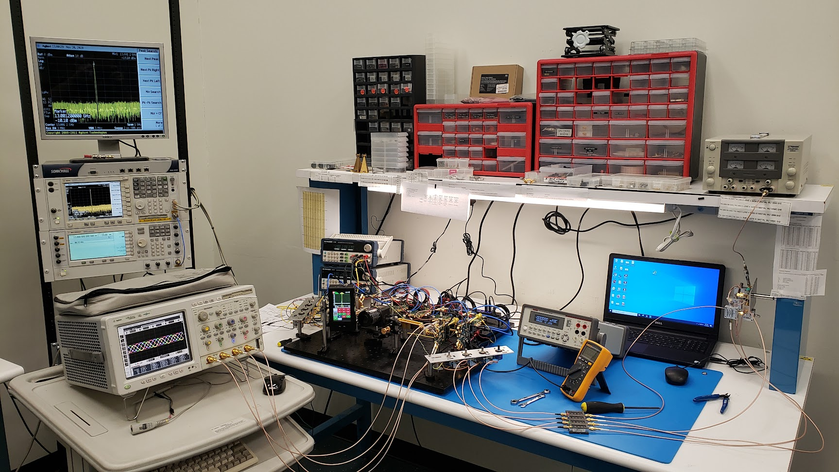
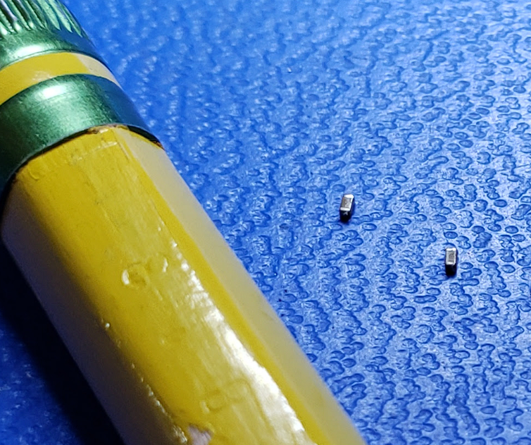
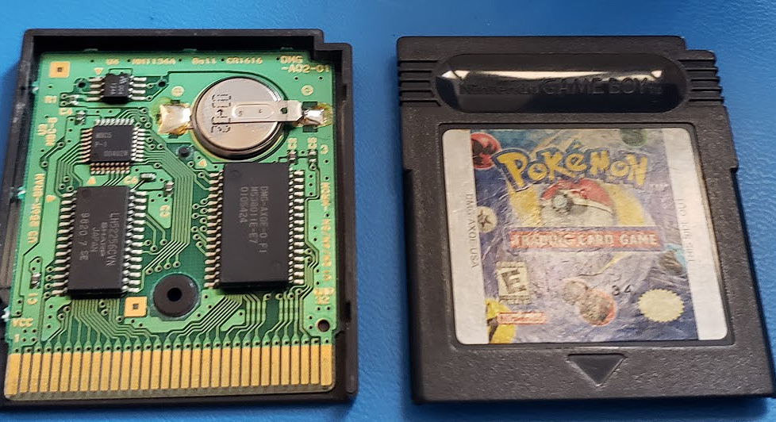
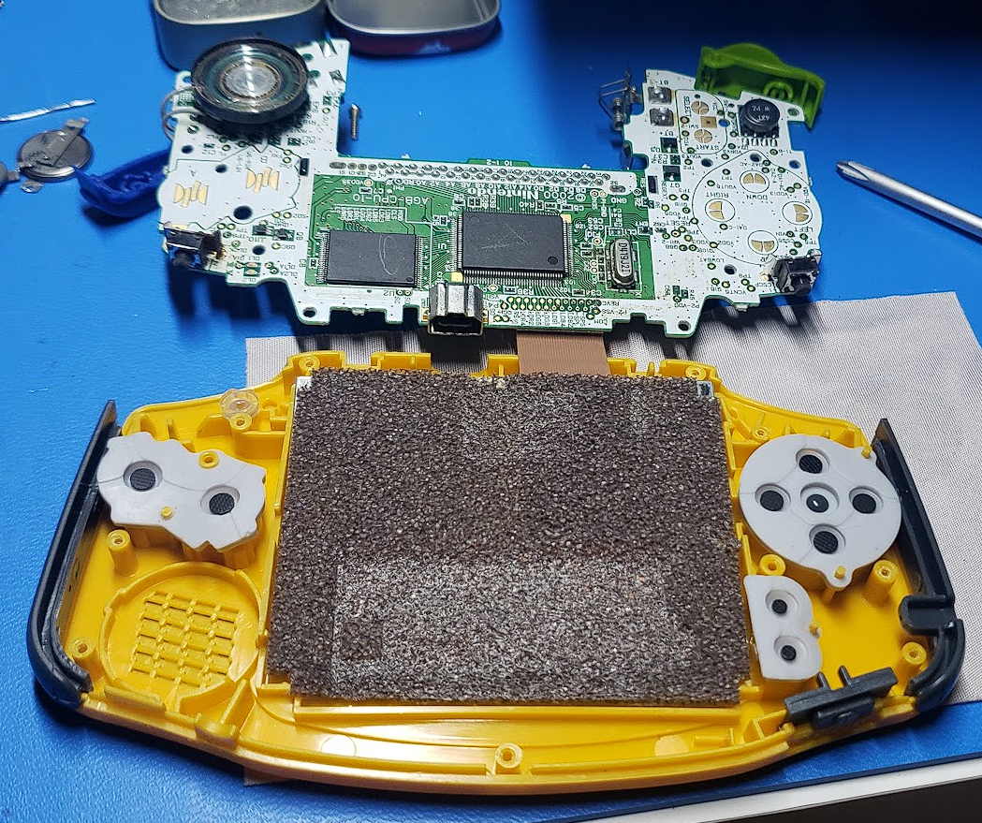
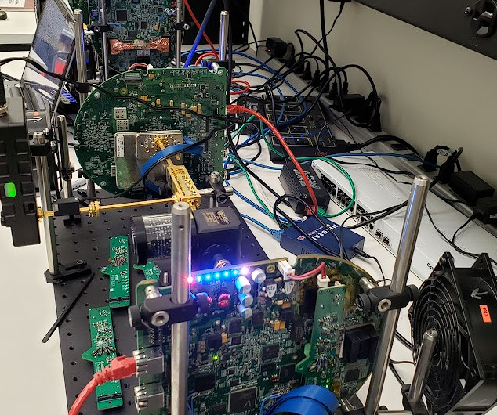
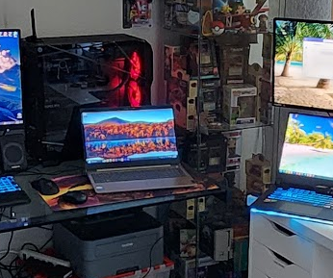
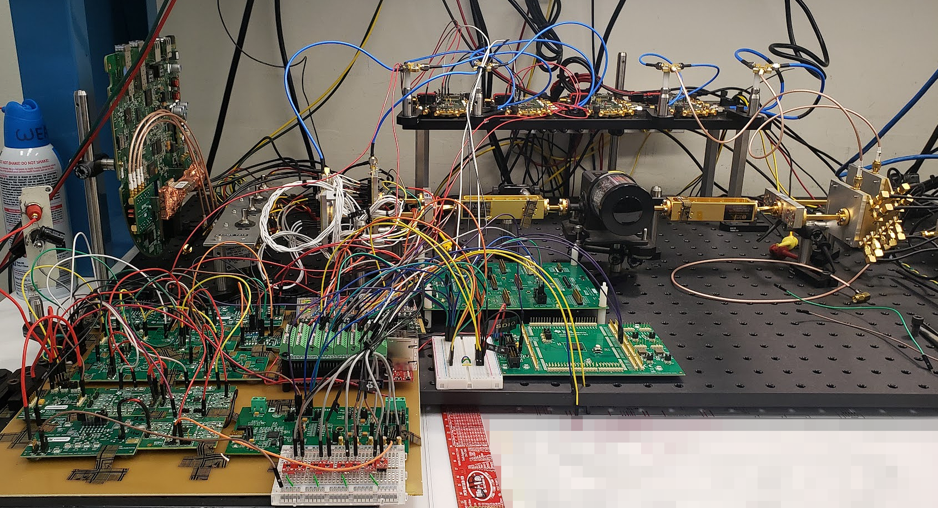
Notes:
But what I spend a lot of time actually doing is looking at huge spreadsheets like this one. This is an actual bill of material spreadsheet I used a few weeks ago.
When I am lucky enough to get some lab time, that looks a bit like this. Where we have some high frequency electronic equipment well as some standard electronic lab stuff like oscilloscopes and power supplies.

Slide 11
Notes:
When I am lucky enough to get some lab time, that looks a bit like this. Where we have some high frequency electronic equipment well as some standard electronic lab stuff like oscilloscopes and power supplies.
And here are some images that I thought were cool, the top left picture is from a few years ago when I was working on removing and replacing those tiny parts on a board. The other two on top are me repairing some Gameboy games. The bottom left and right are images of some “frankensystems” as we like to call them from my job, and the middle bottom is just a snapshot of my home workspace and my bajillion screens.

Slide 12


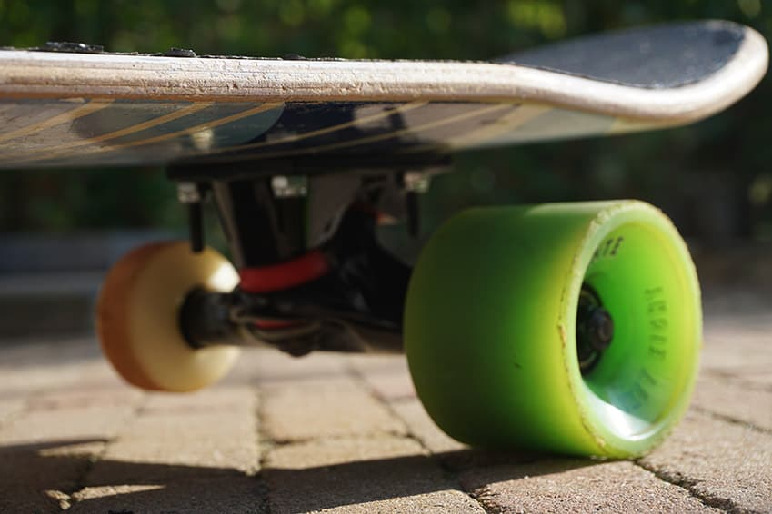



Notes:
And here are some images that I thought were cool, the top left picture is from a few years ago when I was working on removing and replacing those tiny parts on a board. The other two on top are me repairing some Gameboy games. The bottom left and right are images of some “frankensystems” as we like to call them from my job, and the middle bottom is just a snapshot of my home workspace and my bajillion screens
>Here are some pics to highlight hobbies outside of electronics and coding.

Slide 13



Notes:
Here are some pics to highlight hobbies outside of electronics and coding
>And here is my dog who’s just the cutest doggie in the world!

Slide 14
Notes:
And here is my dog who’s just the cutest doggie in the world!
Onward to embedded hardware! What the heck does embedded even mean?

Slide 15
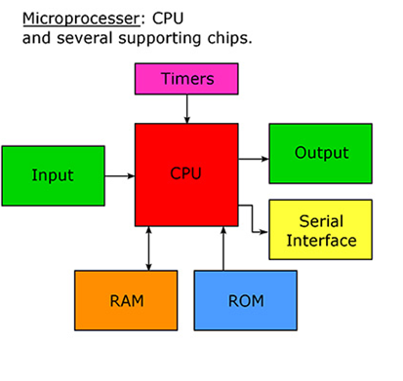
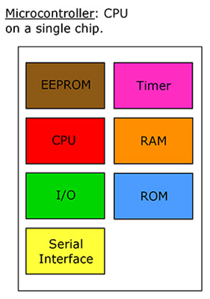
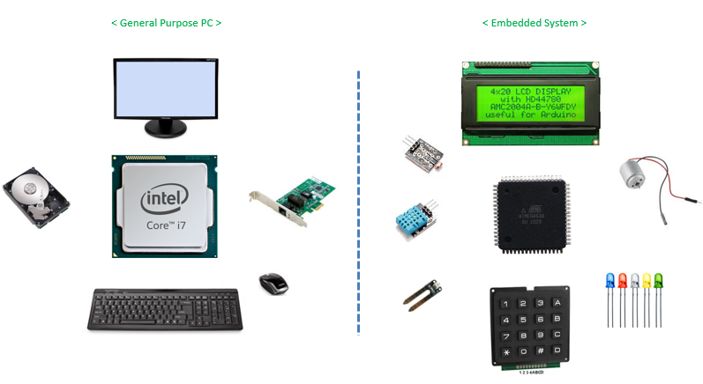
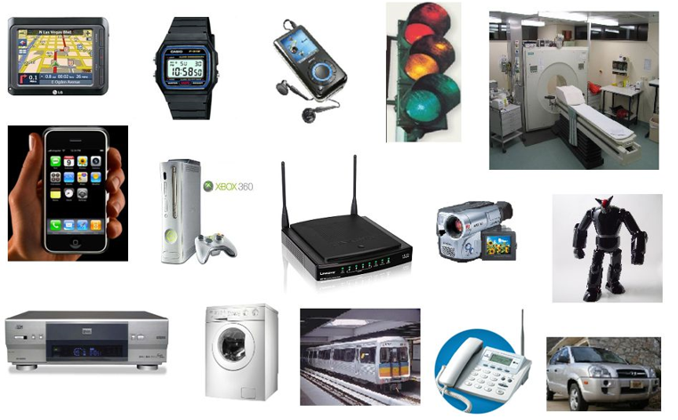
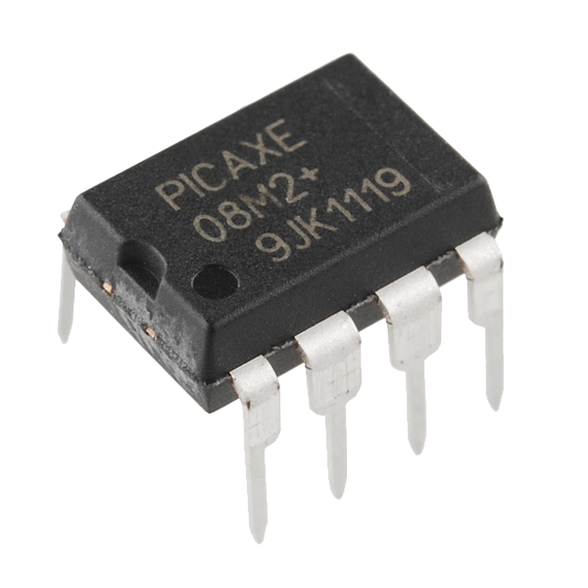
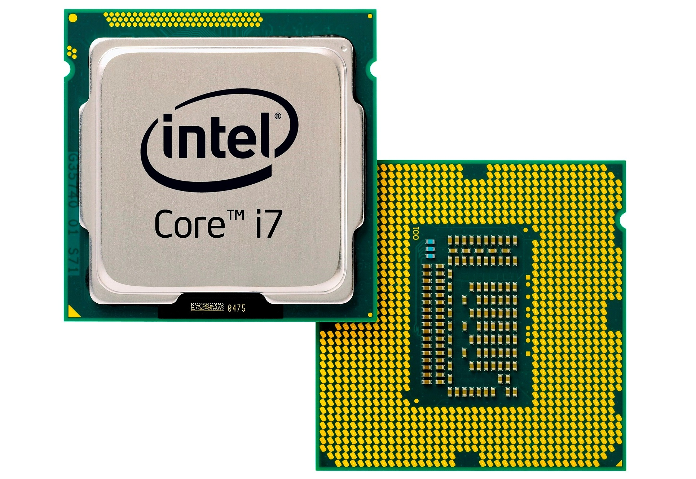
Embedded Hardware
General Purpose PC
development
Embedded System
What the heck does “embedded” mean?
Embedded systems are specialized computers that do not look like your typical computer. They are dedicated to specific tasks and "embed" as part of a larger device.
Majority of modern electronics have some sort of embedded hardware in them with processors running code.
Embedded hardware development involves programming task-specific computers
(microcontrollers or microprocessors).
Notes:
Onward to embedded hardware! So you’re probably asking yourself, what the heck does embedded really mean?

Slide 16
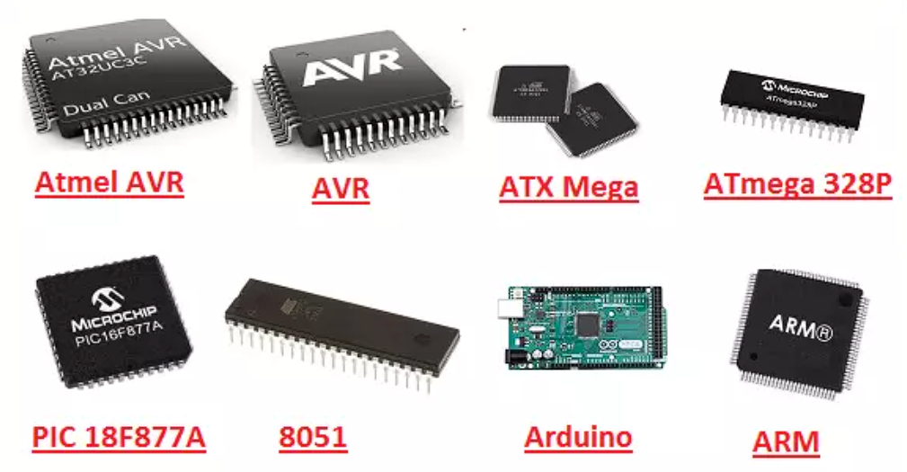
Embedded Hardware
development
A microcontroller is a compact computer on a single integrated circuit (IC) designed to govern specific operations in an embedded system and usually includes built-in memory, peripherals, and input/output pins.
In contrast, a microprocessor is a more general-purpose processor that requires external components like RAM and input/output systems to function, making it more flexible but also more complex to set up.
Notes:
Luckily we’re not touching microprocessors

Slide 17
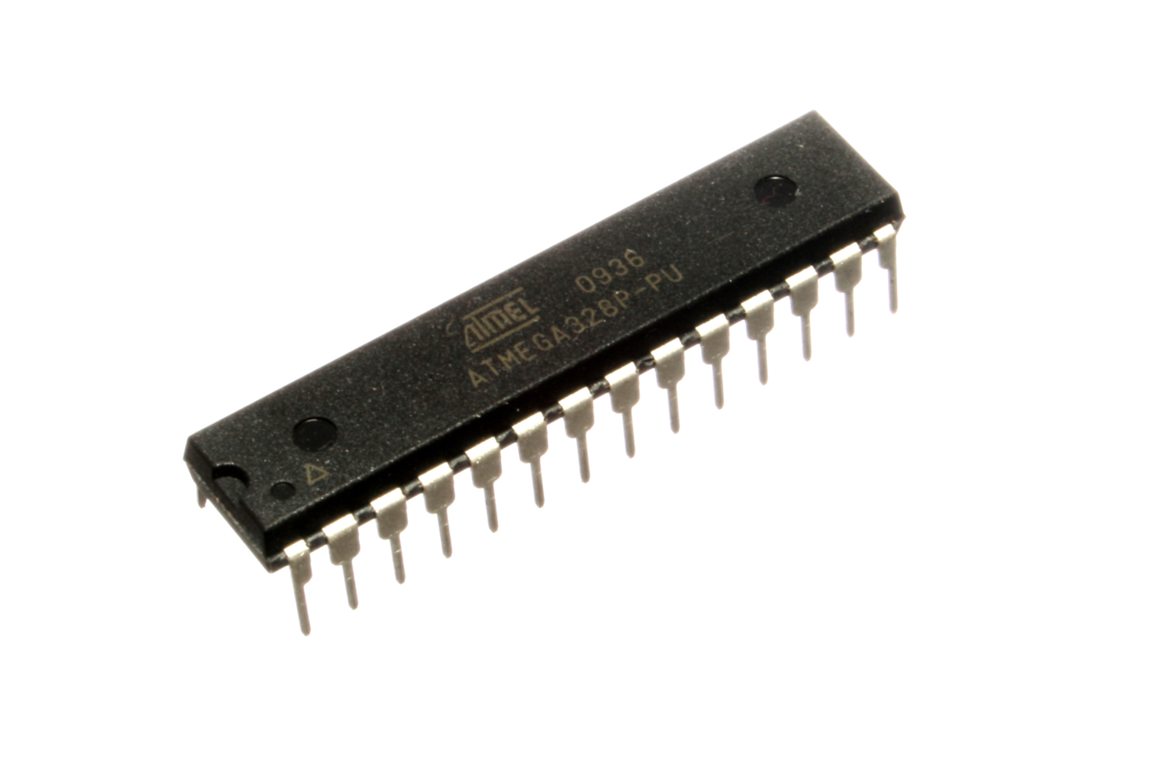
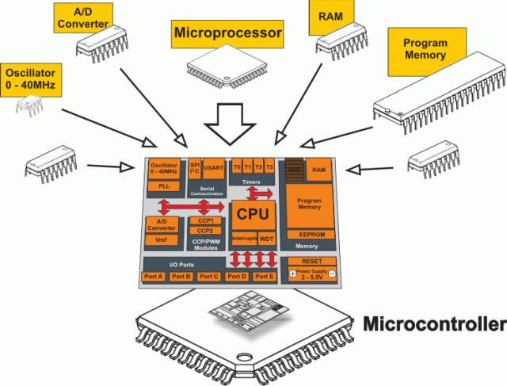
Embedded Hardware
development
Notes:
Luckily we’re not touching microprocessors
We will be focusing on microcontrollers. They are technically computers just like your PC is, but lacking features like an operating system. >Here are some examples of microcontrollers that are commonly available

Slide 18
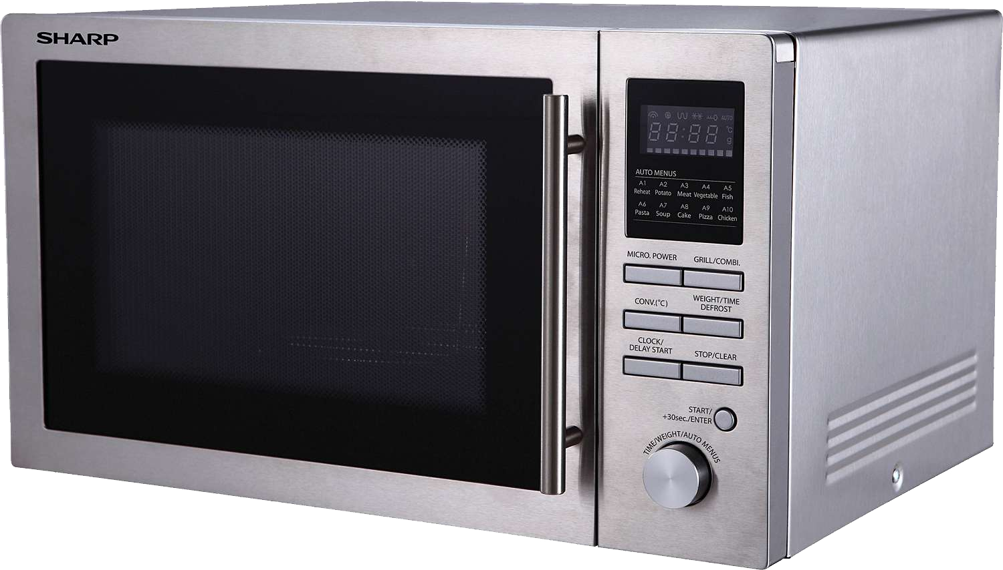
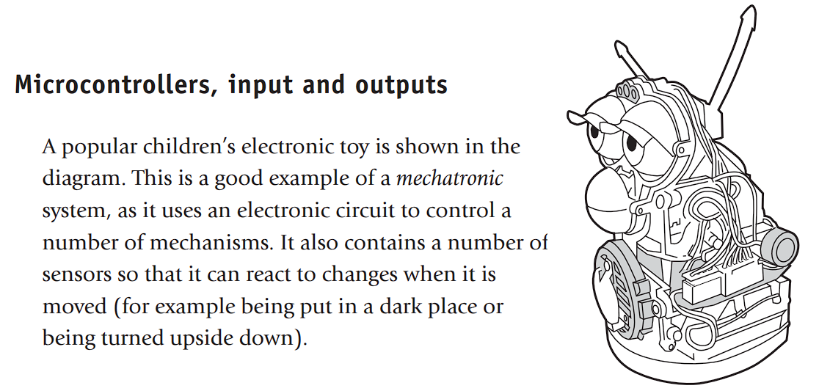
Embedded Hardware
development
Embedded hardware development involves programming task-specific computers
(microcontrollers or microprocessors).
These then perform dedicated tasks or functions within a larger system.
Majority of modern electronics have some sort of embedded hardware in them with processors running code.
Notes:
Here are some examples of microcontrollers that are commonly available
I bet you’re wondering: “Hey, Arduino doesn’t look anything like those. How is it a microcontroller?”
Well, the Arduino is a technically a development kind of board, which houses a microcontroller, allowing for easier accessibility of chip function to the user.
It has interfacing like the USB to computer port and the input output pins to allow access to the microcontroller’s functions. We’ll touch more on that shortly. Most if not all the chips shown here would have some sort of development board available from their respective manufacturers.
> Continuing On: Here’s a great example highlighting the use of microcontrollers in everyday devices

Slide 19
Embedded Hardware
development
A microwave oven could use a single microcontroller to process information from the keypad, display information on the display, and control output devices like the turntable, light, bell, and magnetron
(the thing that heats the food).
These then perform dedicated tasks or functions within a larger system.
Majority of modern electronics have some sort of embedded hardware in them with processors running code.
Notes:
Here’s a great example highlighting the use of microcontrollers in everyday devices
Some other notable examples where there are most certainly microcontrollers at work are:
Traffic lights: controlling the sequence of light changes
Washing machines: controlling the wash cycles
Car Engine Control Unit: Regulates engine performance, optimizing fuel efficiency, and emissions >You guys remember the Furby toy?

Slide 20
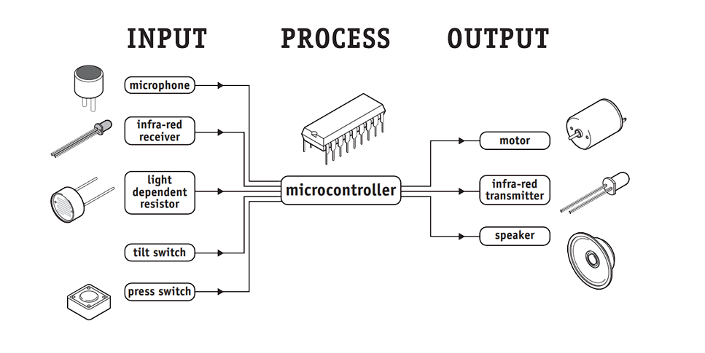

Embedded Hardware
development
Notes:
You guys remember the Furby toy?
**Click for cute pic**
It’s a great example (and a hackable example) for the use of microcontrollers.
It has a defined set of input peripherals, a processor, and output peripherals.
>Here we see those peripherals and can imagine them in action.

Slide 21
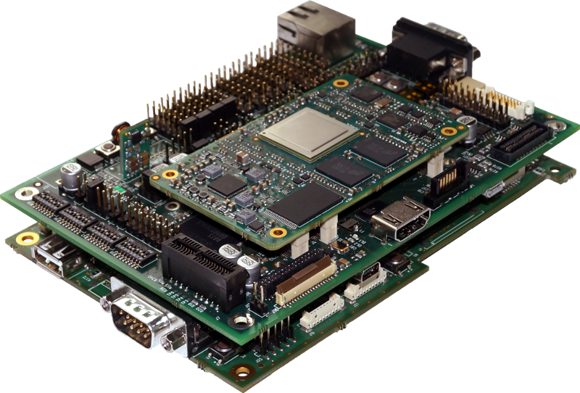
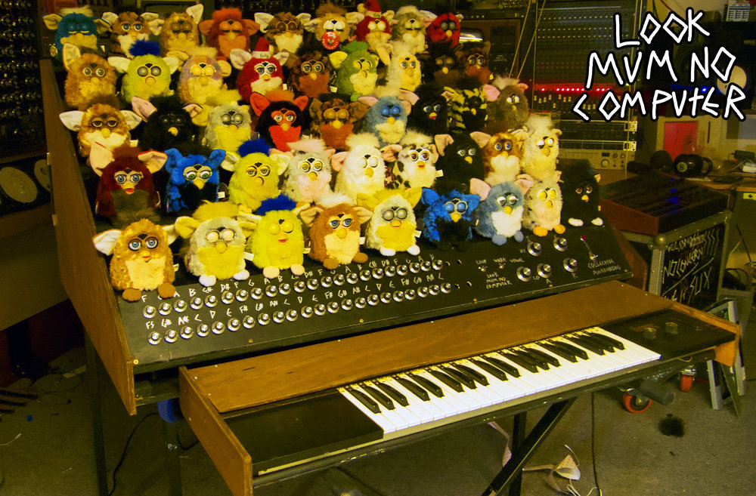
Embedded Hardware
development
Notes:
Here we see those peripherals and can imagine them in action.
For example, if you talk to the furby, it will process input from the microphone, process what to do with that input data, and then process output audio for the speaker.
And when I said it’s a hackable example, that’s due to the simple nature of the toy and the ease of access to its component. As such, it’s popular among hobbyists and “circuit benders”. Here’s an array of Furbys used as audio output for a keyboard organ. The hacker’s youtube channel name is Look Mum No Computer if you want to look it up.

Slide 22
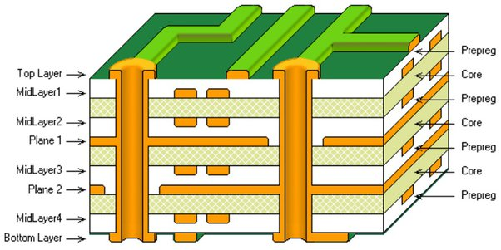
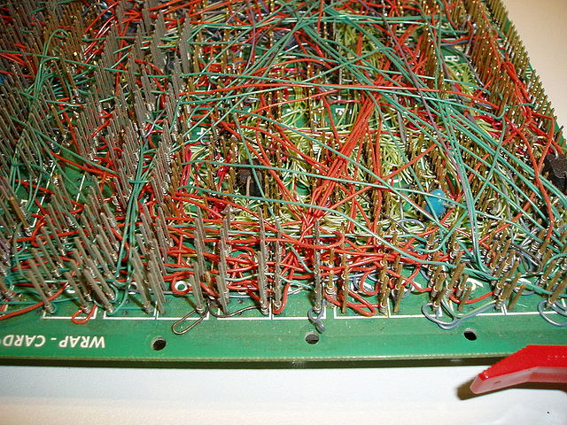
Can be Daunting
Devil in the details
Notes:
Naturally diving into the detailed world of Arduino and embedded hardware might seem scary at first.
But as we unpack each layer, what once seemed complex can become a wellspring of innovation and creativity.
But at least we’re not wire wrapping anymore!

Slide 23
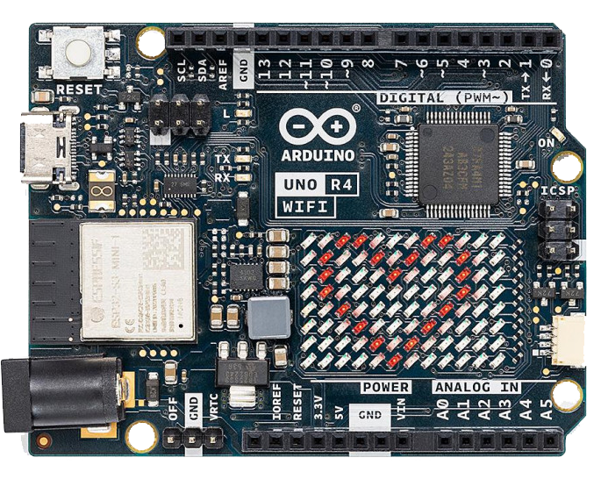
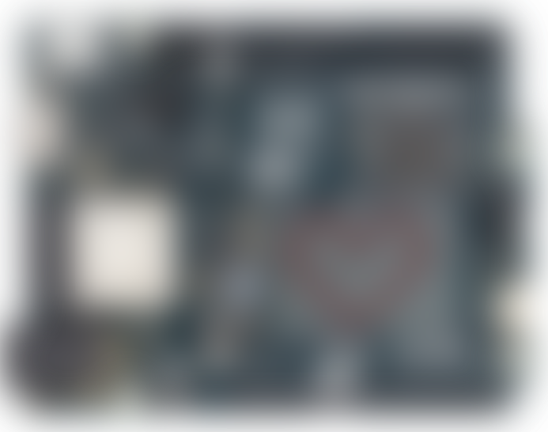
Can be Daunting
Devil in the details
Notes:
But at least we’re not wire wrapping anymore! That’s an old technique where you wrap wires around component pins with a special tool.
It was initially popular in electronics due to its reliability and error-reversibility so it facilitated rapid prototyping.
It was a PITA and yhankfully before my time.
So that said…luckily we have Arduino…

Slide 24
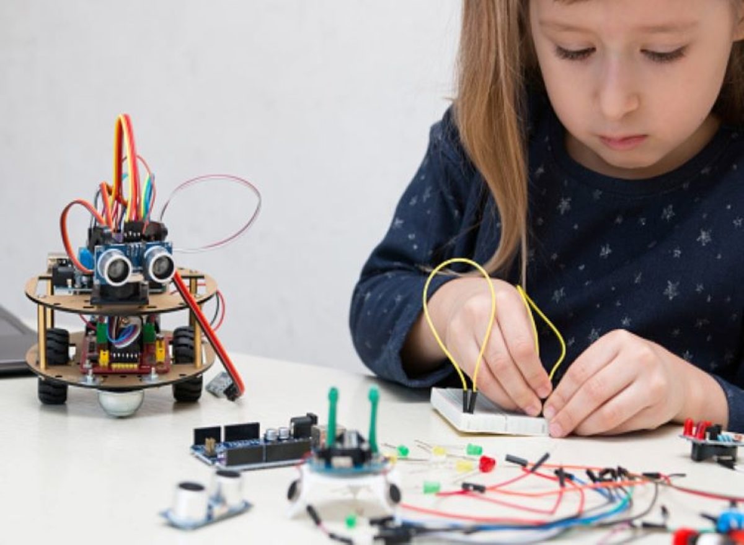
Luckily we have
arduino
Beginner friendly
Notes:
What exactly is Arduino?

Slide 25
Luckily we have
arduino
What is Arduino?
Definition: Arduino is an open-source electronics platform based on easy-to-use hardware and software.
Purpose: Used for building digital devices and interactive objects that can sense and control objects in the physical and digital world.
Beginner friendly
Notes:
So when we say that the Arduino is used "for building digital devices and interactive objects that can sense and control objects in the physical and digital world," we mean that it is a versatile tool that can be the brain behind both simple and complex projects. It can gather data from its surroundings, make decisions based on that data, and then take actions in the real or digital world based on that information. Arduino can be set up to send notifications through emails or SMS. Arduino can interact with cloud platforms to store data or integrate with other digital services. >Beginner friendly, no high voltage or dangerous tools.

Slide 26
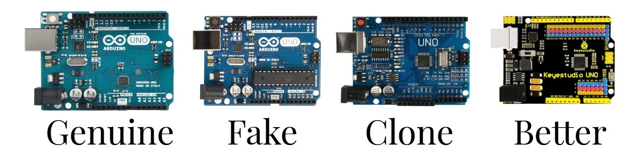
Luckily we have
arduino
Beginner friendly
100% Open Source
Notes:
Beginner friendly, no high voltage or dangerous tools.
>Open source!
Open-source technology refers to software or hardware that is publicly accessible, allowing users to freely use, modify, and distribute the technology, fostering innovation and collaboration.

Slide 27

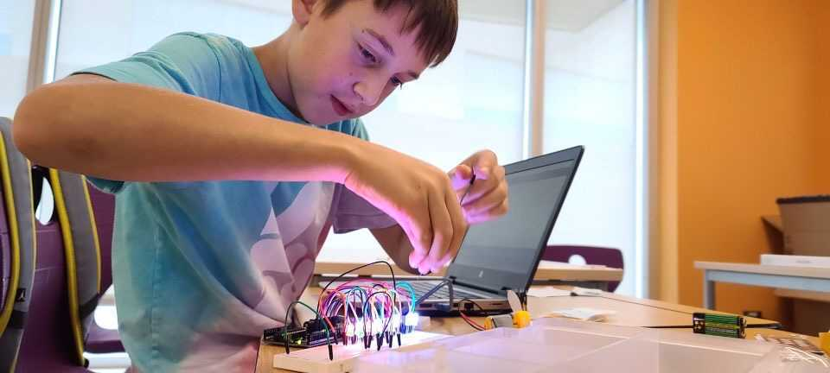
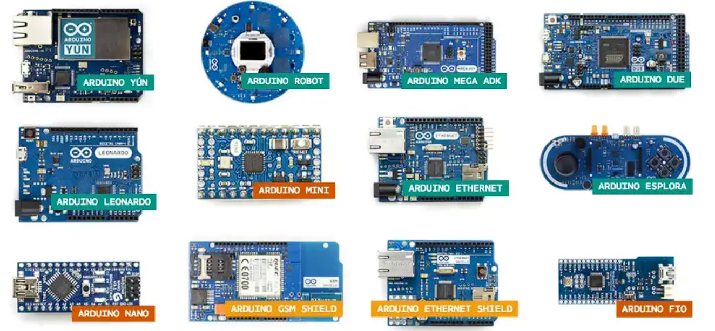
Luckily we have
arduino
Beginner friendly
100% Open Source
Inexpensive
Open-source technology refers to software or hardware that is publicly accessible, allowing users to freely use, modify, and distribute the technology, fostering innovation and collaboration.
Notes:
Open-source technology refers to software or hardware that is publicly accessible, allowing users to freely use, modify, and distribute the technology, fostering innovation and collaboration.
>Inexpensive; lots of options available.

Slide 28
Luckily we have
arduino
Beginner friendly
100% Open Source
Inexpensive
Nice History
Notes:
Inexpensive; lots of options available.
>Has a very modest history with education being the core inspiration.

Slide 29
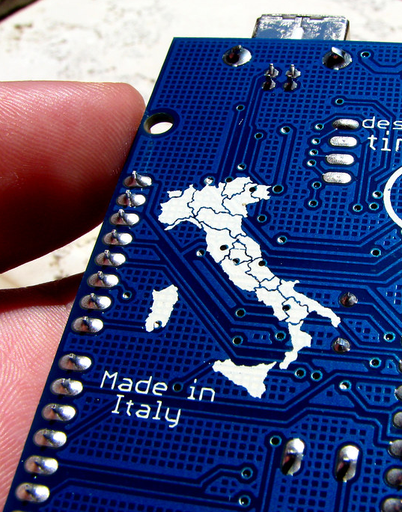

Luckily we have
arduino
Beginner friendly
100% Open Source
Inexpensive
Nice History
Huge Community
Arduino originated from an educational project at the Interaction Design Institute in Ivrea, Italy.
Aiming to provide a low-cost, easy-to-use technology for artists and designers to create interactive objects.
Notes:
Has a very modest history with education being the core inspiration.
>Amazing and fostering community of makers and techies. A genuinely loving community, as is typical of maker spaces promoting equity and inclusivity. (In-kloo-siv-ity)

Slide 30
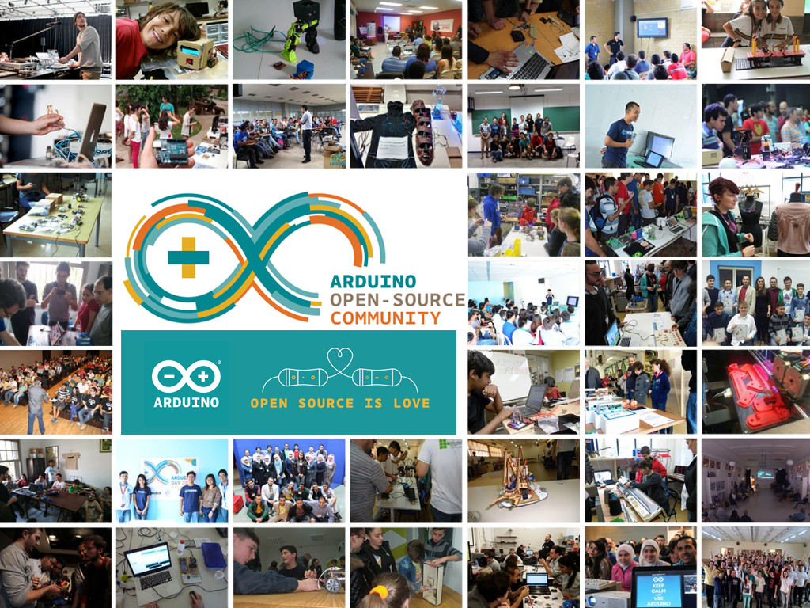
Luckily we have
arduino
Beginner friendly
100% Open Source
Inexpensive
Nice History
Huge Community
The active community around Arduino has created a plethora of free resources, tutorials, and forums for knowledge sharing. A truly beginner-friendly platform.
Notes:
Amazing and fostering community of makers and techies. A genuinely loving community, as is typical of maker spaces promoting equity and inclusivity. (In-kloo-siv-ity)
>Here are some quick examples of how an Arduino can actually be used

Slide 31

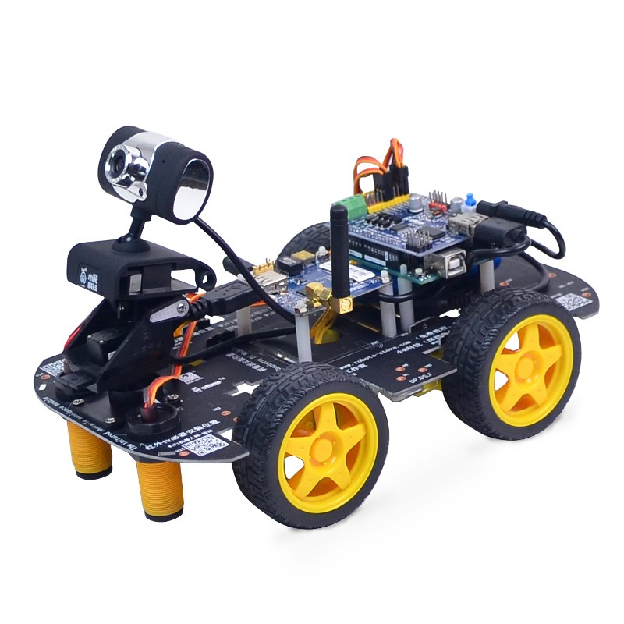
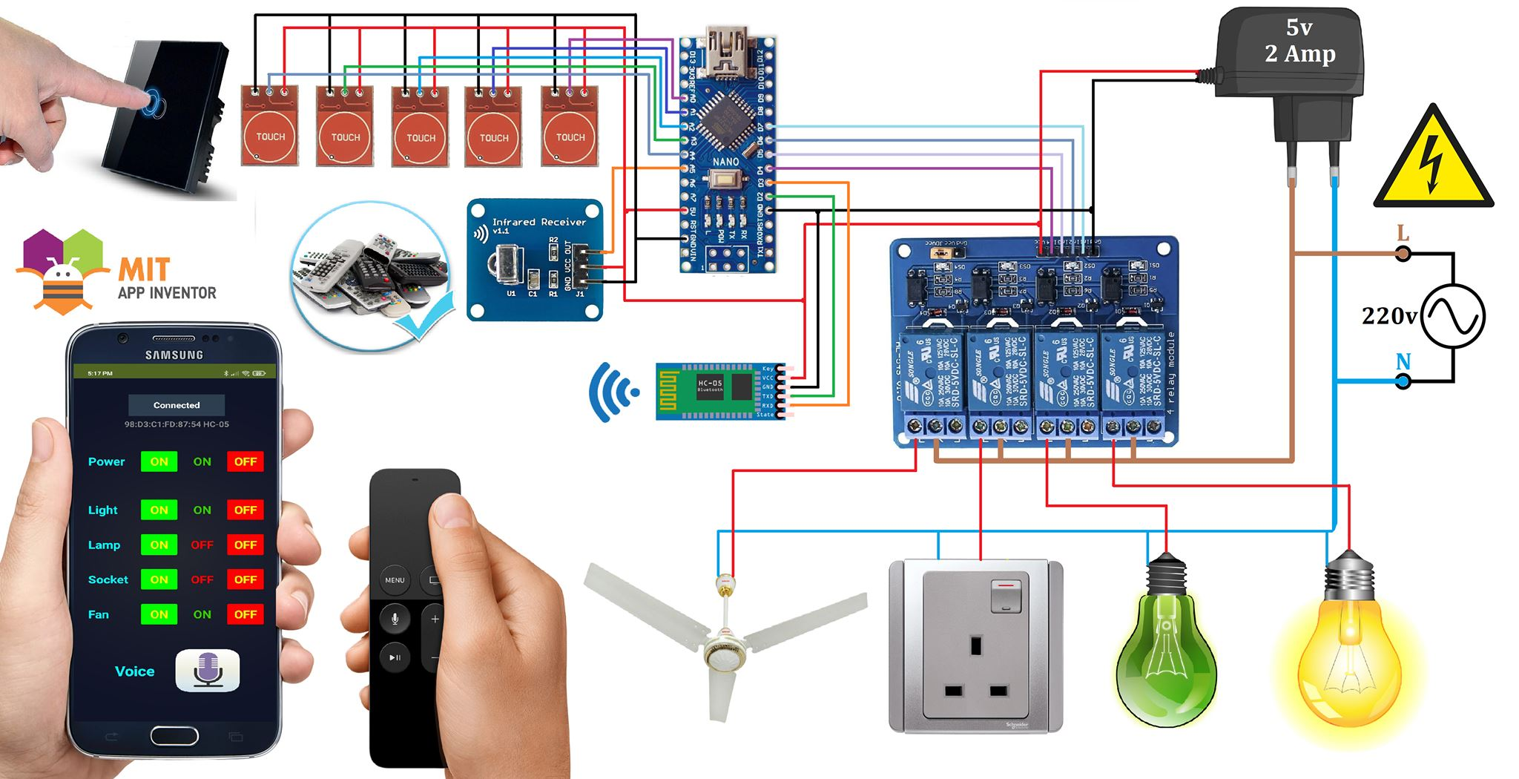
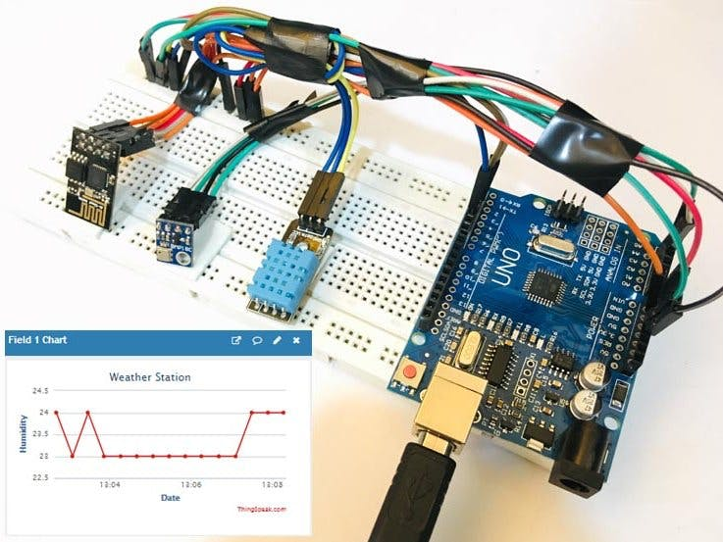
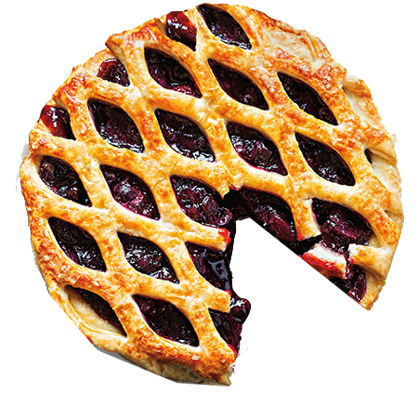

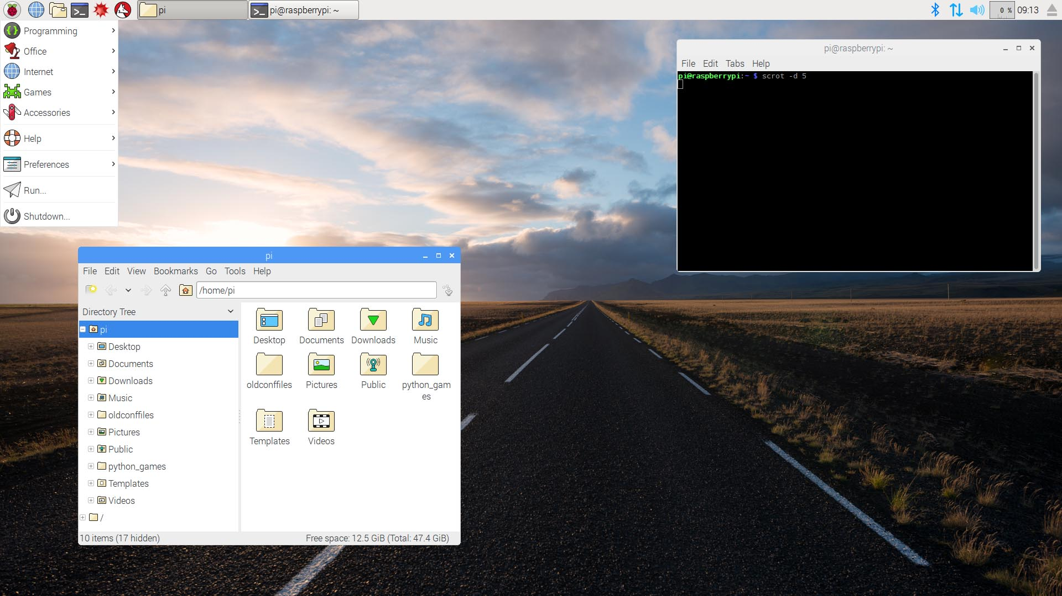
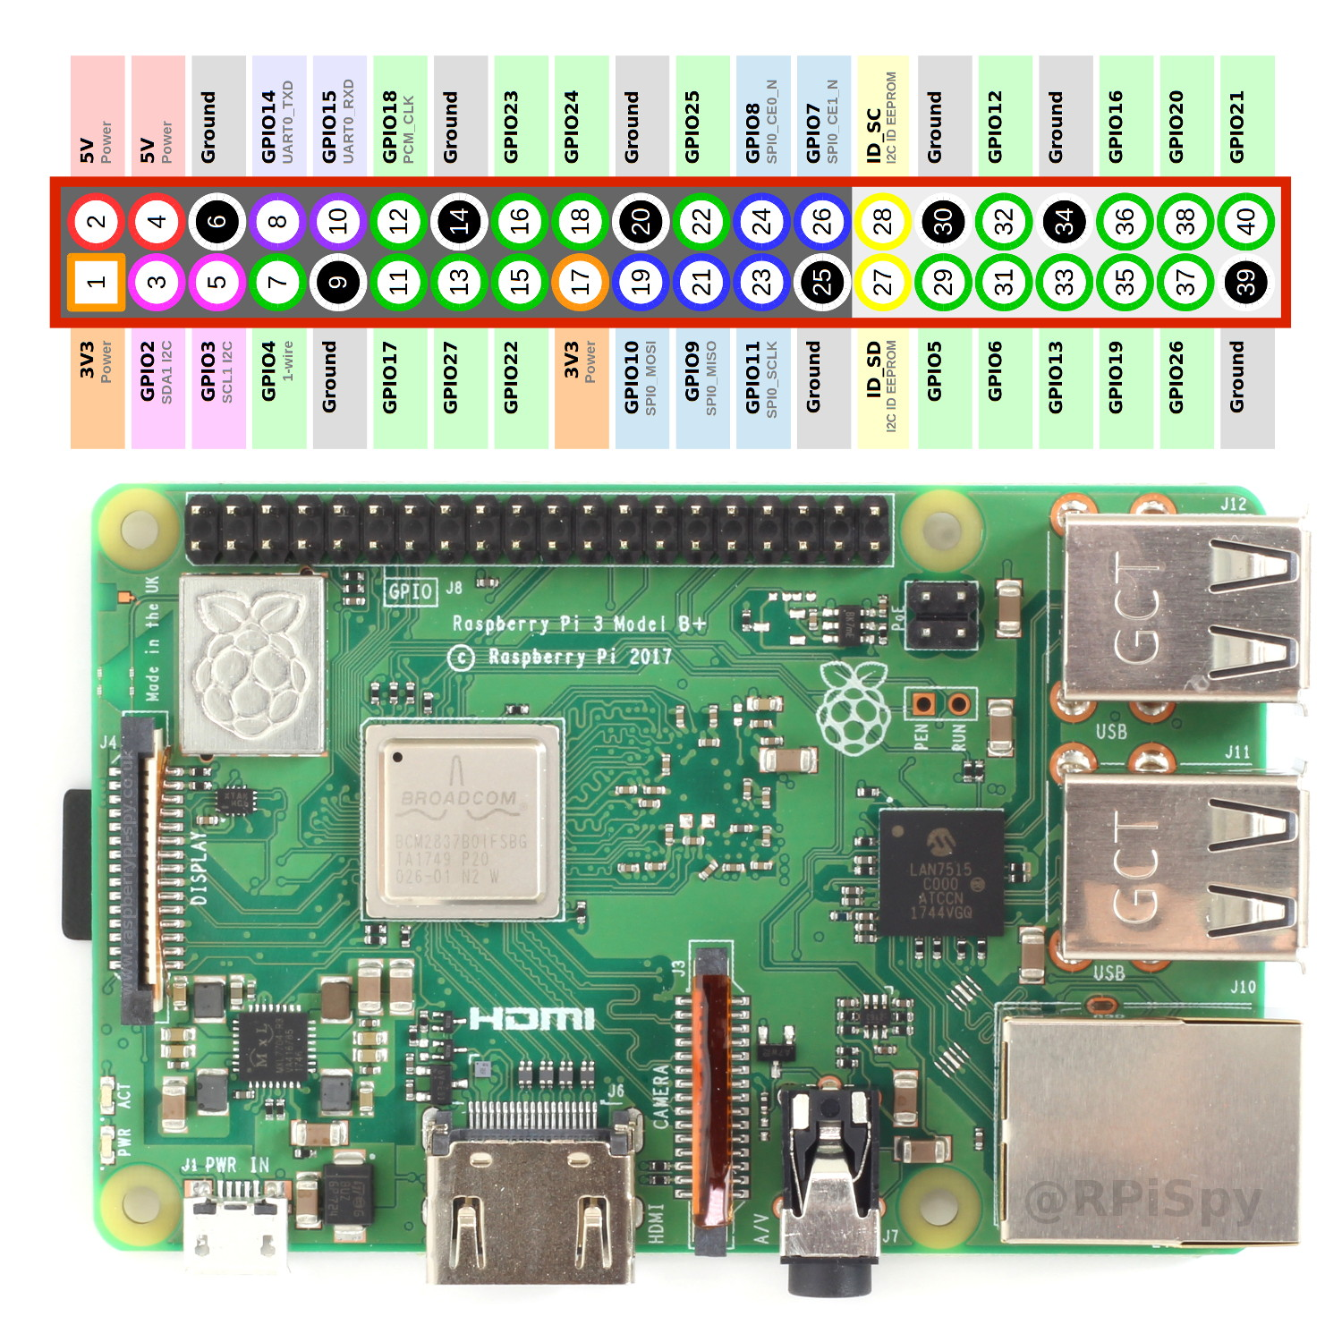
I thought there
would be
Pi?
Low cost, credit-card sized computer
Browse web, HD video, spreadsheets, word-processing, light gaming
HDMI, Ethernet, Headphone/Microphone, USB; keyboard and mouse.
Capable device that enables exploration of computers
Can learn how to program in languages like Scratch and Python
Linux based OS: Raspbian or Raspberry Pi OS.
It also has GPIO pins (general purpose in/out) much like the Arduino.
Examples of
applications
Notes:
Here are some quick examples of how an Arduino can actually be used

Slide 32
Inexpensive computer the size of a credit card
Browse web / HD video / Spreadsheets / Word-Processing / Light Gaming
HDMI / Ethernet / Headphone / Microphone / USB / Keyboard + Mouse
Capable device that enables exploration of computers
Can learn how to program in languages like Scratch and Python
Linux based OS: Raspbian or Raspberry Pi OS.
It also has GPIO pins (general purpose in/out) much like the Arduino
I thought there
would be
Pi?

Slide 33

Why no
What even is a
Pi?
Inexpensive computer the size of a credit card
Browse web / HD video / Spreadsheets / Word-Processing / Light Gaming
HDMI / Ethernet / Headphone / Microphone / USB / Keyboard + Mouse
Capable device that enables exploration of computers
Can learn how to program in languages like Scratch and Python
Linux based OS: Raspbian or Raspberry Pi OS.
It also has GPIO pins (general purpose in/out) much like the Arduino

Slide 34


Why no
Pi?
What’s a
Computing Power: RPI is a full computer with an OS, Arduino is a microcontroller for specific tasks.
Power Consumption: RPI requires more power and usually a dedicated supply, while Arduino is more energy-efficient.
Programming: RPI supports multiple high-level languages; Arduino primarily uses C/C++ and a specific IDE.
I/O Capabilities: RPI offers diverse I/O like HDMI and USB, Arduino mainly has analog and digital pins.
Complexity: RPI is more complex but versatile; Arduino is simpler and easier for beginners.
Notes:
What you can do with a raspberry pi as far as learning about computer science and coding can be done on any regular computer or linux machine. Arduino is more task specific and closer to the actual hardware like sensors and motors and other peripherals. Raspberry Pi definitely has its place in embedded systems, especially in respect to computer science, so I think it would be wise to give it its own presentation another time. Its an entire rabbit hole on its own.

Slide 35



Getting
Familiar
Notes:
So, of course we start with #1, the microcontroller. This is the brain of the Arduino, this is what we’re programming to do work and is responsible for executing the instructions in our code. *click for image* Note that most of the “legs” on the microcontroller are connected to one of these pins here.
*highlight headers*
That’s kind of the whole purpose of the board; breaking out connectivity to the chip for the user. Digital Input/Output Pins: These are the pins used to connect the Arduino to other components and sensors to either receive or send signals. Analog Input Pins: Explain that these pins are used to read analog signals, which can vary across a range of values. Power Supply: Describe how the Arduino can be powered through the USB port or an external power source. Reset Button: A button used to restart the microcontroller, essentially restarting your program from the beginning.

Slide 36





Notes:
Now we focus on what we’re actually going to be physically interfacing with on these boards.
We won’t be touching the microcontroller chip, just plugging wires into the headers that connect to it. (explain headers)
These wires then go on to connect to our peripheral devices, like sensors or motors. Let’s pause and take a second and think about that, with the various inputs and outputs:
We can read data from various sensors or buttons. *click*
We can control motors, LEDs, other actuators, and displays. *click*
We can even communicate with other devices through protocols like SPI, I2C, UART, etc. .

Slide 37

Notes:
Shown here on the left we have an almost hand-drawn representation of the connection points for the microcontroller.
This way of documenting the connection points is often referred to as a “schematic” or “block diagram”. Note that the digital pins on the right side the board correlate to the right of the rectangle in the schematic,
Same with the analog pins on the left side of the board correlating to the left side of the rectangle.
They try to keep schematics close to what’s happening on the physical chip or board itself, but it’s frequently not the case. Always good to double check schematics against real world devices.

Slide 38





Analog pins convert voltage to digital form
Multi-Channel 10-bit ADC (Analog to Digital Converter)
10-bit means input voltages map to digital values of 0 to 1023
x6 Channels (Pins)
Notes:
Here we start diving into a little bit of the logic behind the microcontroller and what makes these pretty neat to use.
The analog pins are named as such because they have the functionality of Analog to Digital conversion; one of the key `purposes of a microcontroller. What that means is they take analog signal, which is voltage, and turn it into a digital representation that we can use in processing.
Majority of sensors output a voltage in an analog form, meaning it’s not digital on-off. Analog signals exhibit a continuous variation, which means that the signal can take any value within a specified range. Voltage, being a continuously varying parameter, can represent these signals accurately. We can take these changes in voltage and map to digital for processing. So a sensor outputting a range of 0 volts to 5 volts into a digital value of 0 to 1023. (2.5V would be mapped to a digital value of about 511 (which is 1023/2))

Slide 39

Voltage Common Collector
-Input
Main supply voltage needed for sensor
operation
Will come from Arduino; 5v pin
Analog pins convert voltage to digital form
GND “Ground”
-It’s there
Required for all circuits to function
Multi-Channel 10-bit ADC (Analog to Digital Converter)
10-bit means input voltages map to digital values of 0 to 1023
x6 Channels (Pins)
SIG/OUT “Signal” -Output
Sensor Device’s Output Signal
Goes to Arduino
TRIG
“Trigger”
-Input
Sensor Device’s Activation
Comes from Arduino
Notes:
Here are a variety of awesome sensors easily available and designed to be used with Arduino and other microcontrollers.
The sensors are pretty easy to use. There is a ground pin, necessary to complete any electronic circuit. You simply wire it to a ground pin location on your Arduino’s pin header. There is a voltage input pin to power the sensor, you can supply the voltage from your Arduino’s 5v header pin with a wire as well.
Then there is the voltage output pin, which is what we give to one of the Arduino’s analog pins to process voltage into digital through the ADC. Some sensors have additional pins, and their usages are easily described and found online. The ultrasonic module, for example, its’ 4th pin is a trigger. It sends an audio pulse and listens for an echo.

Slide 40


Breadboard intro
A breadboard is a solderless device used in the prototyping of electronics.
Allows for easy placement and removal of electronic components and wires.
Create temporary circuits for testing and experimentation, facilitating design before finalizing a circuit in a permanent form such as a printed circuit board (PCB).

Slide 41




Slide 42

What is a
Breadboard?

Slide 44


Slide 45






Slide 46



Slide 47


Slide 48


int ledPin = 13;
void setup() {
pinMode(ledPin, OUTPUT);
}
void loop() {
digitalWrite(ledPin, HIGH); delay(1500);
digitalWrite(ledPin, LOW);
delay(1500);
}

Slide 49


int ledPin = 13;
void setup() {
pinMode(ledPin, OUTPUT);
}
void loop() {
digitalWrite(ledPin, HIGH); delay(1500);
digitalWrite(ledPin, LOW);
delay(1500);
}

Slide 50


int ledPin = 13;
void setup() {
pinMode(ledPin, OUTPUT);
}
void loop() {
digitalWrite(ledPin, HIGH); delay(1500);
digitalWrite(ledPin, LOW);
delay(1500);
}
Notes:
Here is theone is the Arduino IDE for windows. Itconnects to your Arduino board via USB, allowing for the uploading and writing of code to the microcontroller. The neat thing about the IDE is that it had a code editor, and tons of pre-written example programs to get started. *click* If you’re curious to see where the actual “main” function resides, it is in the Arduino core library, and it generally looks like this. We would hardly ever touch that though. I never have. No need.

Slide 51



Integrated
Development
environment

Slide 52


Slide 53

A short circuit is a zero-resistance shortcut between two sides of a power source—for example, if the positive and negative terminals of a battery directly touch. It’s a bad thing and should be avoided.

Slide 54





We use a resistor in series with an LED to limit the current flowing through the LED.
LEDs have a characteristic called forward voltage, which is the voltage across the LED when it is conducting current. Beyond this forward voltage, the current through the LED increases rapidly with a small increase in voltage, a phenomenon described by the LED's I-V curve.
If we connect an LED directly to a power source without a resistor to limit the current, the current through the LED could become large enough to damage or destroy the LED. Moreover, exceeding the current rating of the LED can also lead to overheating and can potentially damage other components or the power source itself.
Identify the forward voltage (Vf) and the forward current (If) of the LED from the LED's datasheet. Common values might be Vf = 2.0V and If = 20mA for a red LED, but these values can vary.
Identify the voltage of your power source; for an Arduino, you might be using a 5V or 3.3V pin.
Use Ohm's law to find the resistance value:
where:
R is the resistance value you’re solving for
Vsource​ is the voltage of your power source
Vf​ is the forward voltage of the LED
If​ is the forward current of the LED
For example, if you’re using a 5V source, with an LED that has a forward voltage of 2.0V and a forward current of 20mA (0.02A), the resistance would be calculated as:
4. Choose a resistor with a value equal to or slightly greater than the calculated value to ensure the current will be less than or equal to the LED's forward current. In the above example, a 150Ω or 220Ω resistor would be suitable. Our kits have 330Ω. Bigger is better.
Adding a resistor helps to keep the LED operating safely within its specified parameters, ensuring a long lifespan for the LED and preventing damage to the Arduino's output pins.

Slide 55


330 Ω (OHM)
Resistor
int ledPin = 13;
void setup() {
pinMode(ledPin, OUTPUT);
}
void loop() {
digitalWrite(ledPin, HIGH); delay(1500);
digitalWrite(ledPin, LOW);
delay(1500);
}

Slide 56



#define BUTTON_PIN 12
void setup() {
pinMode(BUTTON_PIN, INPUT_PULLUP);
Serial.begin(9600);
}
void loop() {
int value = digitalRead(BUTTON_PIN); Serial.print(value);
delay(1000);
}

Slide 57


#define BUTTON_PIN 12
void setup() {
pinMode(BUTTON_PIN, INPUT_PULLUP);
Serial.begin(9600);
}
void loop() {
int value = digitalRead(BUTTON_PIN); Serial.print(value);
delay(1000);
}

Slide 58



Slide 59



Slide 60


Slide 62


We are all
Makers

